Slide 1

`
WELCOME
to our website
DoorToDoor Services
Your Imagination to your Door Steps

Slide 2


p
roject
resentation
on
DoorToDoor Services
Your Imagination to your Door Steps
Presented To:
Dr. Naveen Tiwari
Associate Professor
GEHU , Bhimtal
Presented By :
Team ( Gitesh [BCA], Charanjeet[BSC IT],
Deepak[BCA], Vijay[BCA])

Slide 3
Introduction
Technology used
What To Expect Ahead ….
Why Door to Door Service?
Website Screenshot
Conclusion
References

Slide 4
What is Door to Door Service/ Delivery?
In today’s life everyone is busy with their work and sometimes they don’t have enough time to visit stores or meet the person who can solve their issues.
So, we are here.
Our motto will help you to bring,
YOUR IMAGINATION TO YOUR DOORSTEP.

Slide 5
This website will help you to get your daily needs at your doorstep. Even small to small services are available in it.
In this website you will be getting services like:
Transport/Courier Service
Product Delivery
Grocery
Technical Helper/ Adviser
Electrician
Cleaner
Gardening
Baby Sitting
Food Order
Event Management
Healthcare/ Nursing
Home Tutor
Mechanical Helper/ Adviser

Slide 6
NODEJS
Backend Designing
NODEJS
BOOTSTRAP
BOOTSTRAP
Frontend Designing
JAVA SCRIPT
Human Interface
JAVA SCRIPT
HTML+CSS
HTML+CSS
Frontend Designing
MONGO DB
Database Designing
MONGO DB
TECHNOLOGY USED

Slide 7
What is Bootstrap?
Bootstrap is a free front-end framework (HTML and CSS) for faster and easier web development.
Bootstrap is famous for being developed with components that have the ability to follow the property of responsive designs.
Responsive Design is about using CSS and HTML to resize, hide, shrink, enlarge, or move the content to make it look good on any screen
Responsive Design allow your page works for computer, tablets and mobile phones.

Slide 8
What is Cascading Style Sheets(CSS) ?
Contains the rules for the presentation of HTML.
CSS was introduced to keep the presentation information separate from HTML markup (content).

Slide 9
What is JavaScript(js) ?
JavaScript enhances Web pages with dynamic and interactive features.
JavaScript runs in client software.
JavaScript 1.3 works with version 4.0 browsers.
JavaScript gives HTML designers a programming tool
JavaScript can react to events. Validate data
It can be used to detect the visitor's browser
Create cookies.
Read/write/modify HTML elements

Slide 10
What is NodeJS ?
In simple words Node.js is ‘server-side JavaScript’.
In not-so-simple words Node.js is a high- performance network applications framework, well optimized for high concurrent environments. It’s a command line tool.
In ‘Node.js’ , ‘.js’ doesn’t mean that its solely written JavaScript. It is 40% JS and 60% C++.

Slide 11
Path
1
jsonwebtoken
2
Mongoose
8
Dot-env
7
3
Express
Cookie-parser
6
4
hbs
5
Some Node.js Module used in our website
bcryptjs

Slide 12
Why Choose Door to Door Service?
This website helps customers to
Single Point of Contact for the Entire Delivery
They do not need to maintain checks and balances at every stage of the shipment transfer. This means they only need to contact or add items to their “door2door services-delivery” account and confirm shipping.
Added Advantage of Insurance
With door-to-door delivery, the shipping provider also provides you with insurance for damaged and lost goods. Enquire about this with your delivery partner and ask if you need to activate it before, will they enable it automatically for every shipment.

Slide 13
Reduced Costs
Door-to-door delivery does not require you to spend any additional costs at every stage of the fulfillment process. All the processes starting from the dispatch of products from your warehouse to the delivery of the product to the end customer, everything is done at one go. Therefore, customers do not need to arrange for any first-mile or last-mile delivery separately.
Decreased Operational Efforts
They do not have to waste time or efforts on resource and fleet management for logistics. You can spend this time on your core business, product development, etc. With door-to-door delivery service, you can align resources toward marketing and sales of your product and overlook the entire logistics process.
Easier to Manage

Slide 14
Website Screenshots

Slide 15
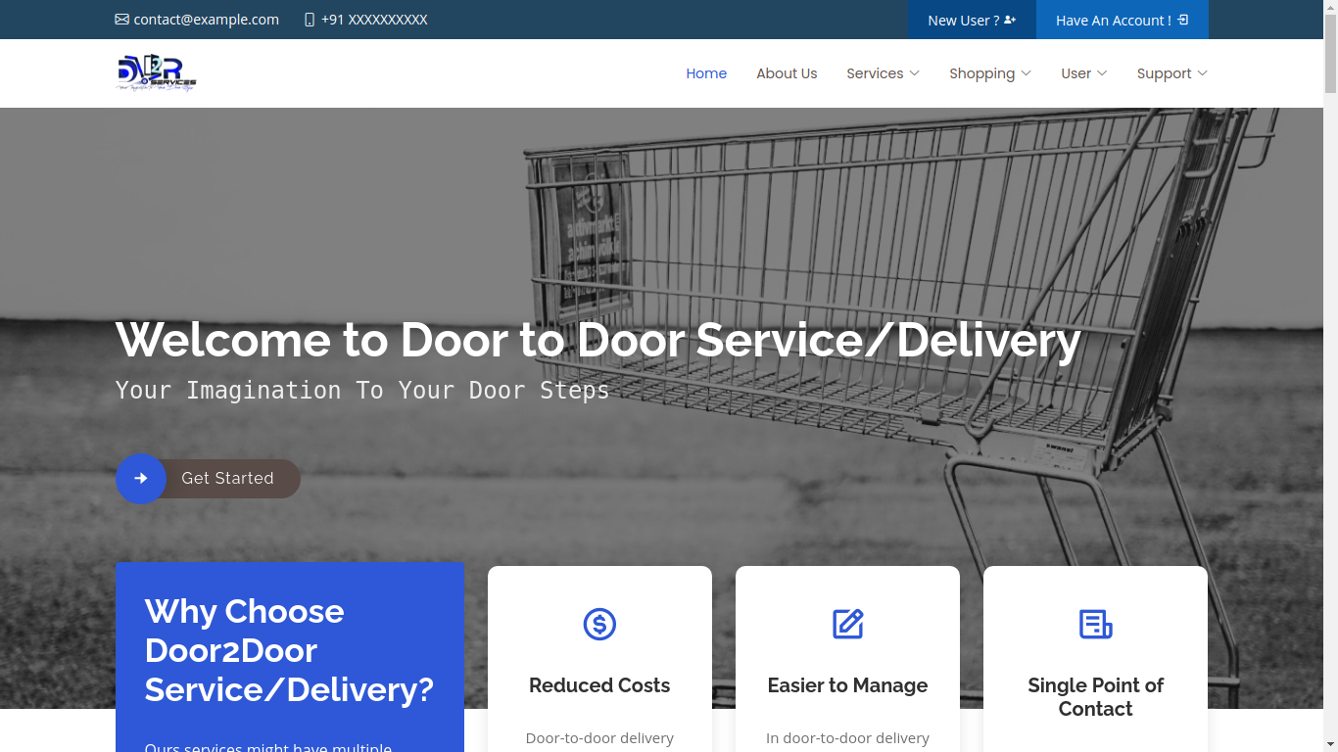
H
O
M
E
P
A
G
E
H
O
M
E
P
A
G
E
1
1

Slide 16
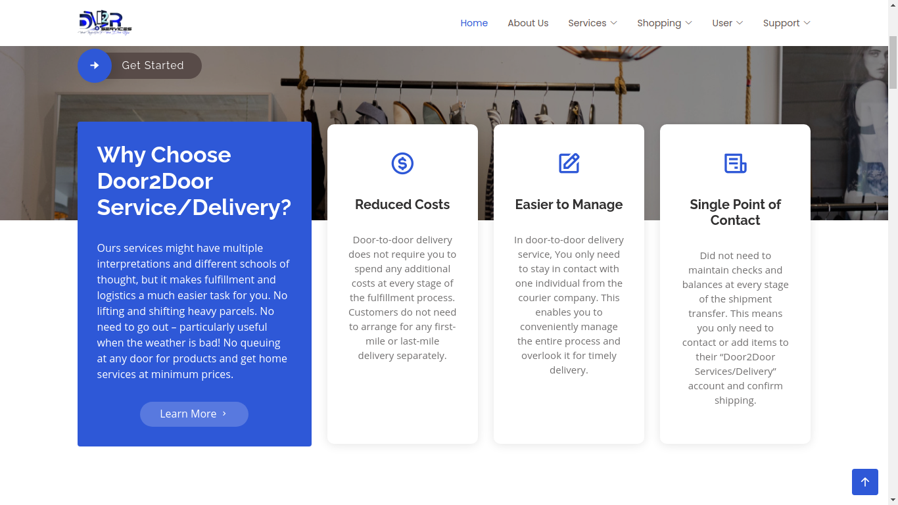
H
O
M
E
P
A
G
E
H
O
M
E
P
A
G
E
2

Slide 17
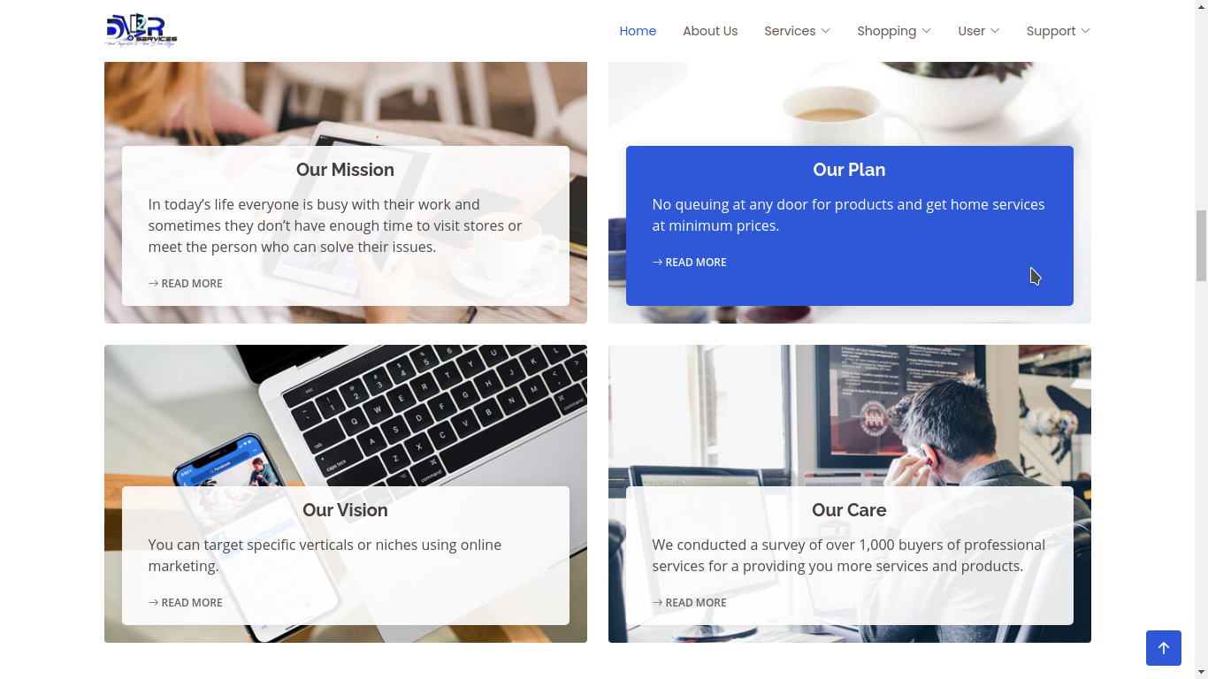
H
O
M
E
P
A
G
E
H
O
M
E
P
A
G
E
3

Slide 18
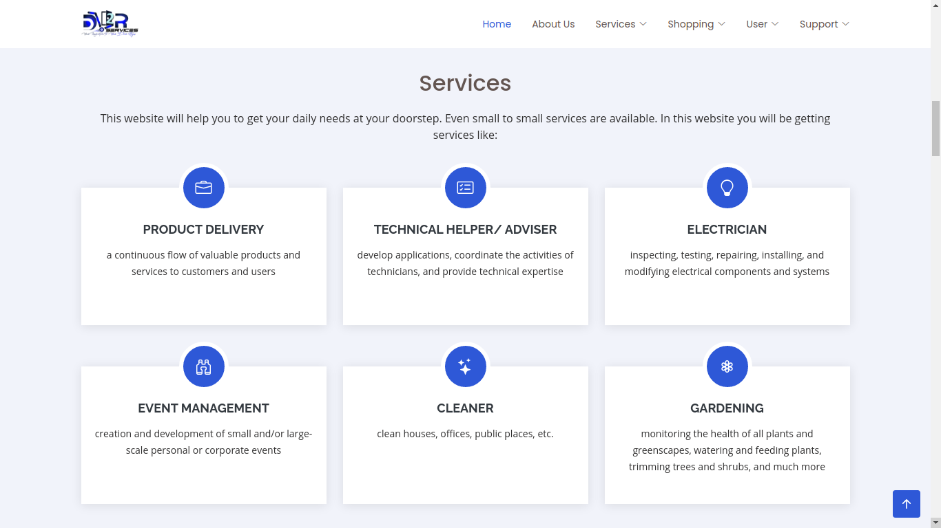
H
O
M
E
P
A
G
E
H
O
M
E
P
A
G
E
4

Slide 19
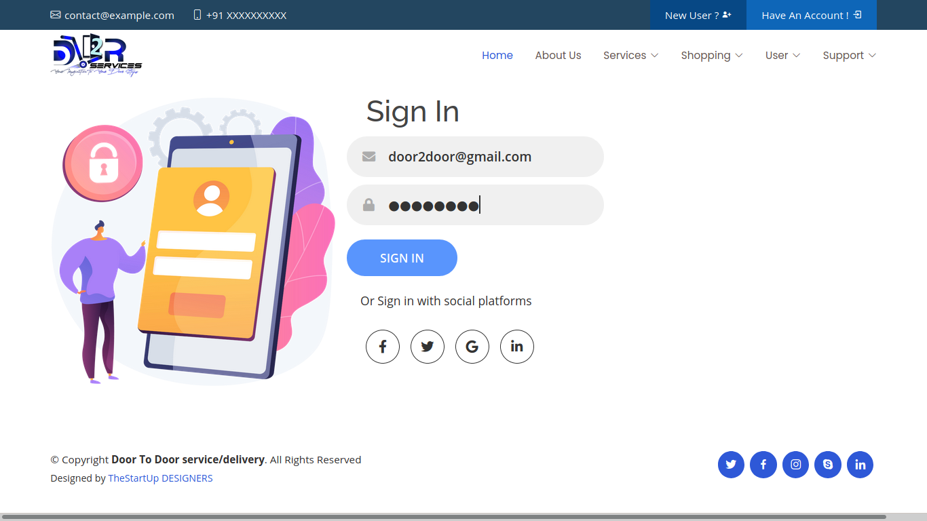
S
I
G
N
I
N
P
A
G
E
5

Slide 20
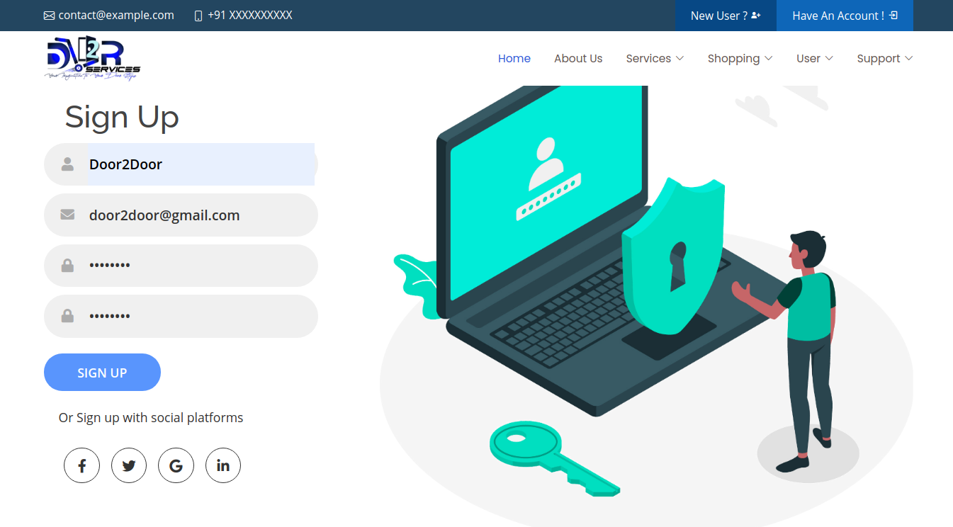
S
I
G
N
U
P
P
A
G
E
6

Slide 21
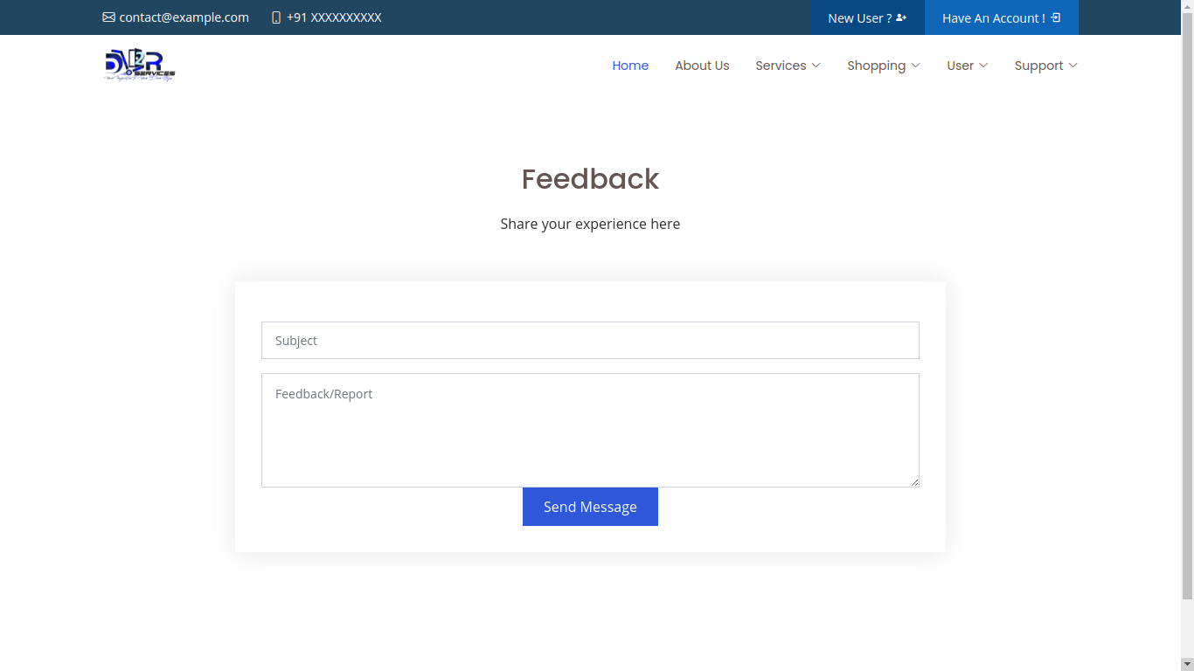
F
E
E
D
B
A
C
K
7

Slide 22
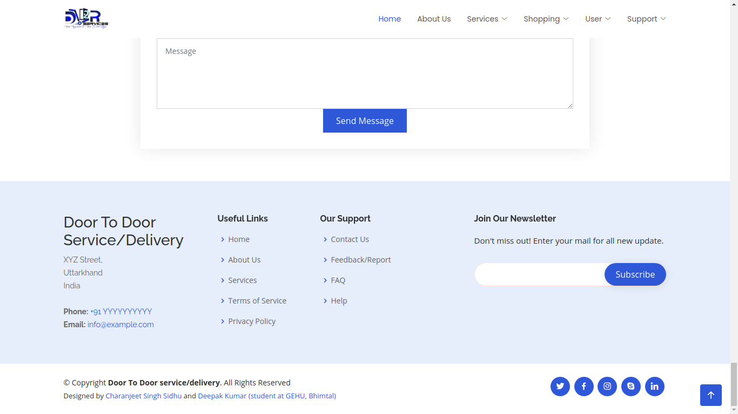
S
E
N
D
M
E
S
S
A
G
E
8

Slide 23
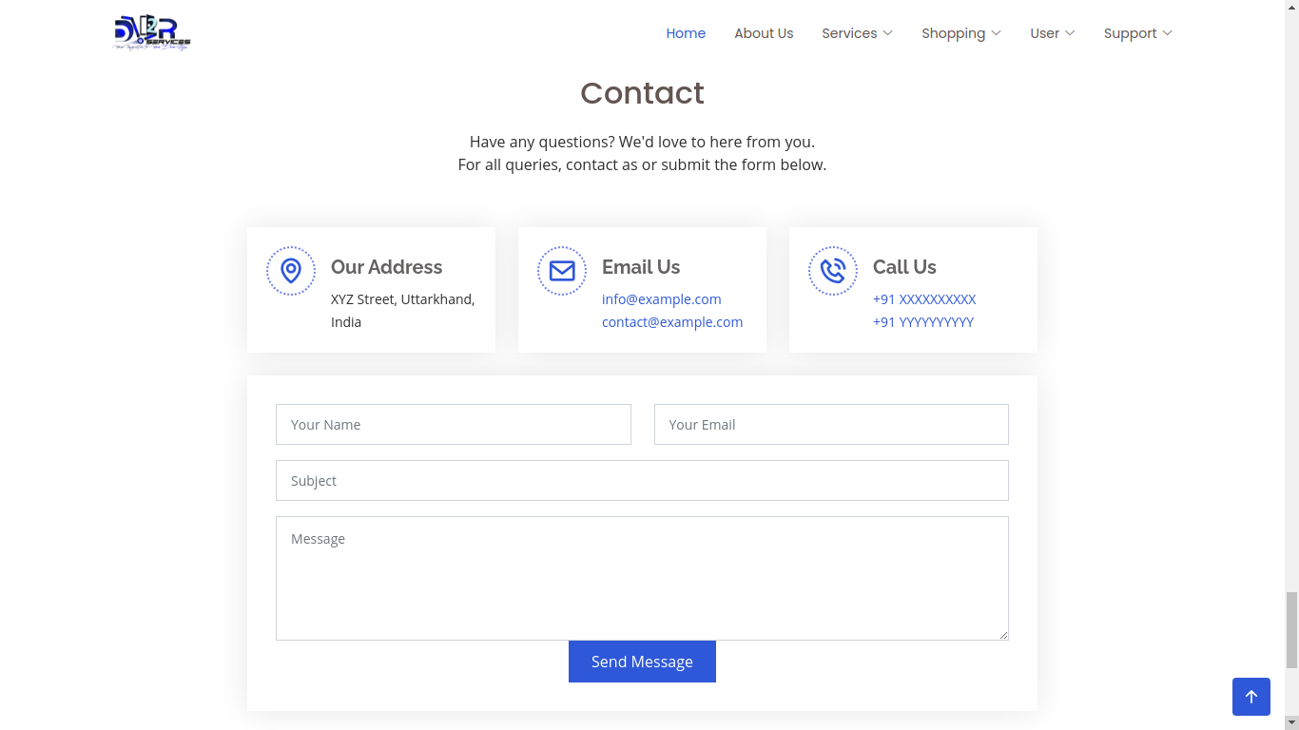
C
O
N
T
A
C
T
U
S
9

Slide 24
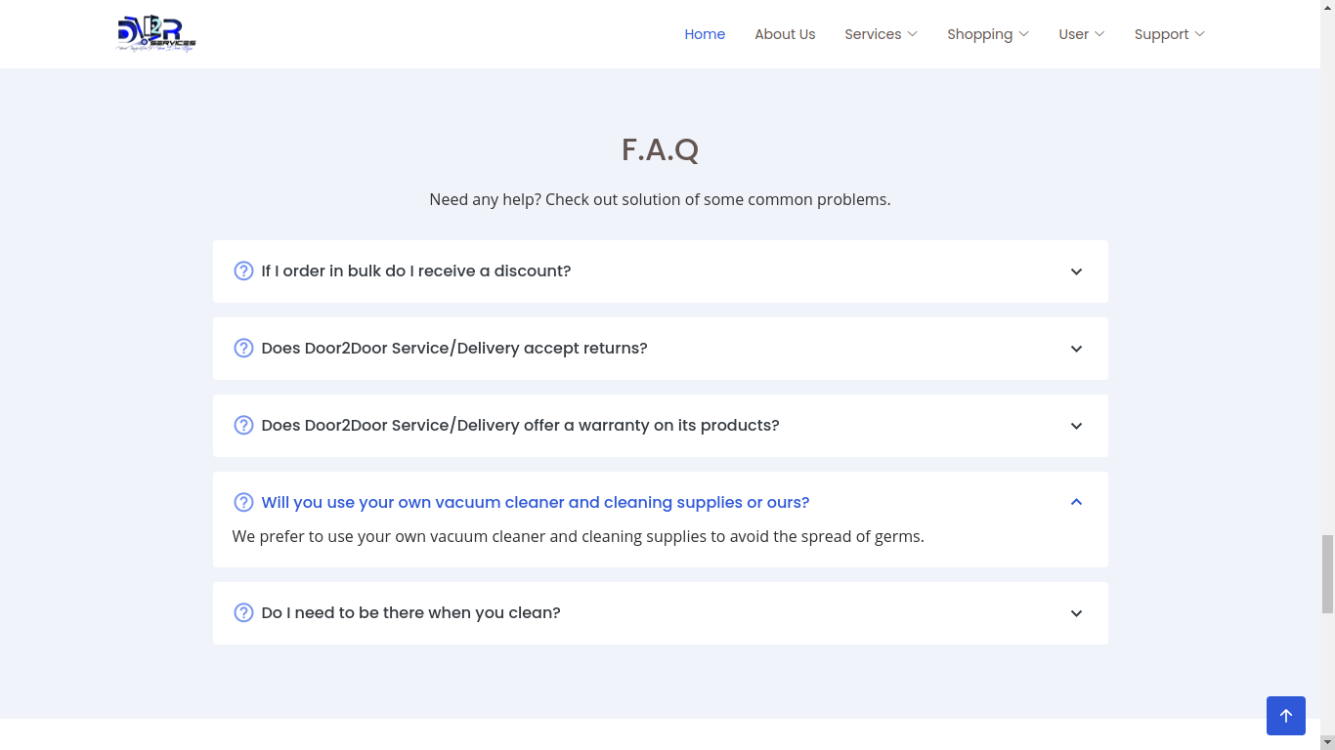
10
F
A
Q

Slide 25
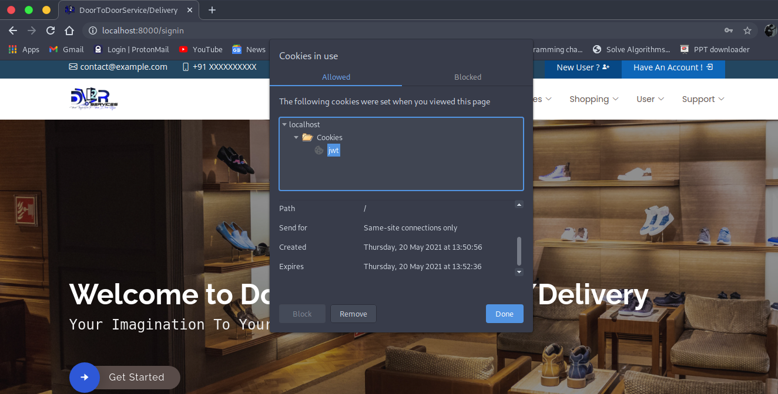
C
O
O
K
I
E
s
11

Slide 26
CONCLUSION
Door-to-door delivery services might have multiple interpretations and different
schools of thought, but it makes fulfillment and logistics a much easier task for
you. If you haven’t yet, reach out to our website “door2door services/delivery” and
start delivering your products or get services at your door soon!
No lifting and shifting heavy parcels. No need to go out – particularly useful when
the weather is bad! No queuing at any door for products and home services at
minimum prices.

Slide 27
REFERENCES
Internet Links:
1. https://1000projects.org/projects/cse-projects-with-source-code
2. https://www.tutorialspoint.com/mongodb/index.htm
3. https://www.w3schools.com/html/default.asp
4. https://www.codecademy.com/catalog/language/javascript
5. https://www.coursera.org/learn/server-side-nodejs
Books:
1. HTML & CSS: Design and Build Websites (By: John Duckett)
2. Learning Web Design (Book by Jennifer Niederst Robbins)
3. JavaScript and jQuery Interactive Front-End Web Development (Book by David McFarland)

Slide 28
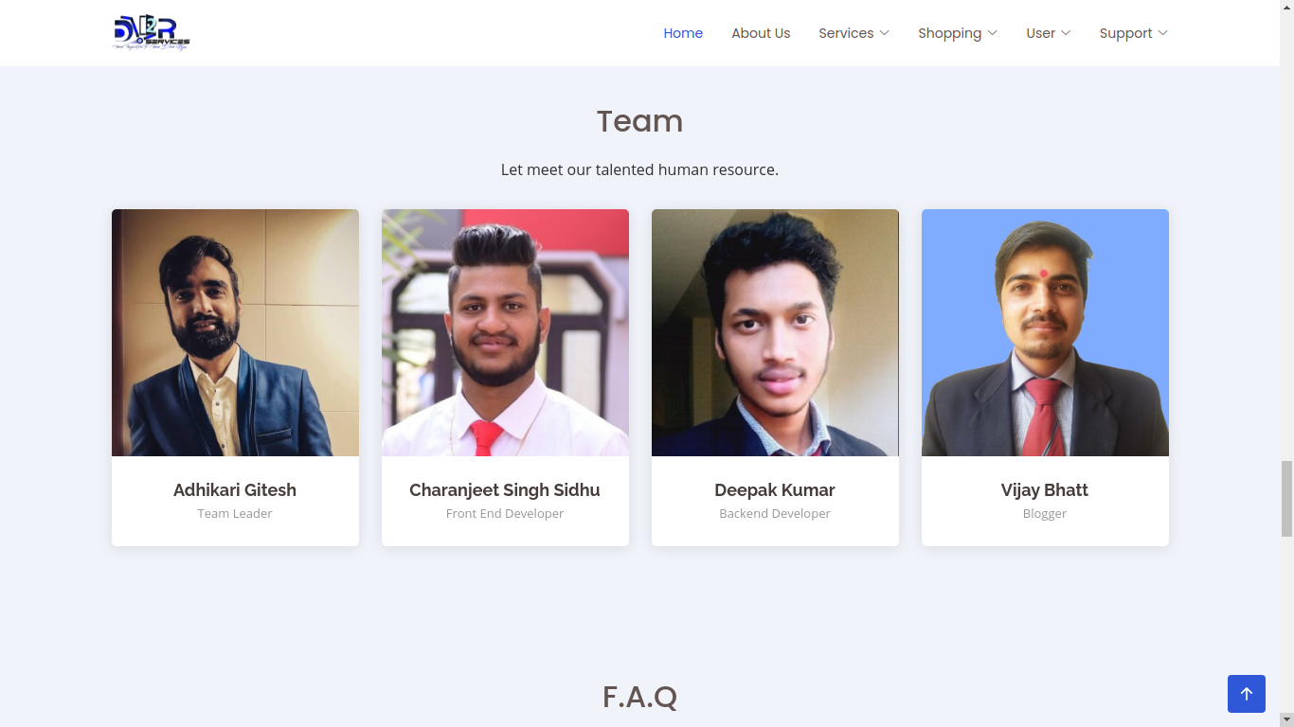
T
E
A
Members
Adhikari Gitesh (Team Leader)
Charanjeet Singh (Front-end Designer)
Deepak Kumar(Back-end Designer)
Vijay Bhatt (Blogger)

Slide 29
Thank
you
Cs Framework’s Presents

